Slide 1
The Composers Toolbox
Or
How to compose music

Slide 2
Equipment needed for this session
Glocks/Xylos
Keyboards
U/t perc
Found sounds
Body sounds (including the voice)

Slide 3
Before we begin…
What are your children going to be allowed to play?
Classroom instruments
Keyboards
Computers/DAWs
Guitars
If they are having lessons, their instrument
Found sounds
Body sounds (including the voice)

Slide 4
The Basics
All music has to start and end somehow
All Start/end together (How to organise this?)
One at a time (How to organise this?)
Notes:
Practical: appoint a conductor/leader
Most common music works in 4s. Leader counts upto 4 – everyone claps (on the beat). Easy!

Slide 5
Format 1
All music is built around a format (or a structure)
The most simple is an Ostinato (repeated pattern)
Here, we’re just using rhythms:
Everyone should have a different pattern…
Patterns can easily be taught through word associations: Drinks (Tea, Coffee, Cocacola, Lemonade etc), or perhaps football teams (Leeds, Burnley, Liverpool, Man united etc)
Notes:
Practical: No – (next slide)

Slide 6
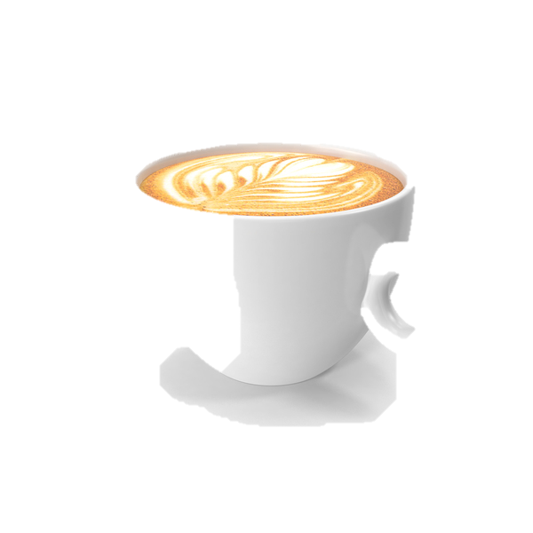
Drinks
Notes:
In your table groups, each person to choose 4 drinks and repeat over and over so that everyone has a unique 4 drink pattern.
Choose a leader/conductor to organise the start
Decide how you’re going to start (and stop)
At some point everyone should be playing.
Aim for around 30 seconds lonk

Slide 7
Notes:
Practical:
Here’s a piece for the whole group
Each table to learn a line
GT/ND leads

Slide 8
Format 2
Ostinatos don’t just have to be rhythms, simple tune patterns (again repeating) can be used
Here, we’re just using pentatonic tunes (5 notes!):
Everyone should have a different pattern…
Make a little repeating pattern (over 4 counts) using only the notes A, B, C, E, G
Why not write your pattern down
Notes:
Practical: Use tuned perc
Pentatonic Ostinato

Slide 9
Format 3
Of course, it would be good to use both rhythmic and melodic ideas in an Ostinato to give more interest (if only for the listeners sake!)
Thinking about themes for your creations, It’s easy with this Form to create music for Clocks, Factories (Rhythm Ostinatos), Rivers, Calm scenes etc (Melodic Ostinatos)
Everyone should have a different pattern…
Repeating patterns should work over 4 counts
Why not write your pattern down
Notes:
Practical: In table groups, have a selection of insts. Devise rhythms/tuned Ostinatos. Organise starting and stopping etc…..

Slide 10
Format 4
In the Art Gallery project, we’re writing music for pictures, so we need other forms perhaps to help
Whist there are formal structures (Binary, Ternary, Rondo etc) perhaps a more useful approach is to analyse the picture and go from there
Notes:
Practical: No

Slide 11
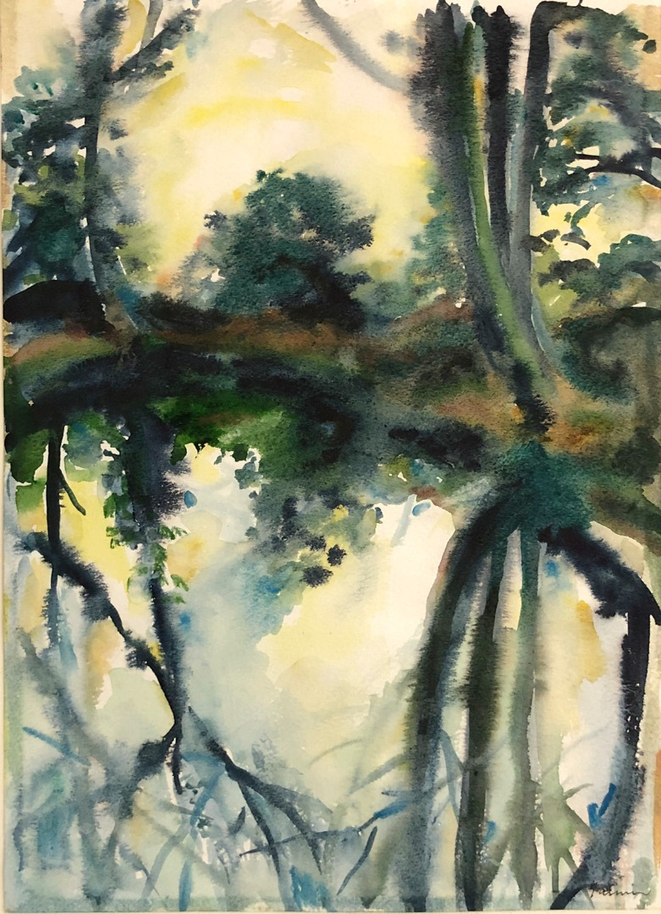
Format 4
Let’s simply analyse this picture
It features reflections (reflections in Music equate to echoes)
Autumnal colours (metal sounds?)
Stillness (slow)
Peaceful (quiet)
This piece might be based just around echoes using ostinato patterns. If using a melodic pattern the group will need multiple tuned instruments to enable the echoing….
Notes:
Practical: No

Slide 12
The Elements
Music is made up of several ‘elements’ which, when all used together serve to form a whole
It's as if a composer has them in a toolbox to use as they wish (!)
The elements are rhythm, pulse, duration, pitch, tempo, timbre, texture, melody, structure, and harmony.
Notes:
Rhythm: Done earlier (drinks)
Pulse is all about the invisible beat. Play the counting game in their heads. It’s how musicians play together
Duration: How long notes last. In the picture we just looked at, the notes might be long to emphasise the stillness
Pitch: Choose whether to play high or low
Tempo: the speed of the music. The picture will dictate to a large degree what the speed of the music will be
Timbre and Texture: the sounds you use and how they blend together (Think about the metal instrument ideas for the piece we just looked at
Melody: Done
Structure: Done (ish)
Harmony: Coming up

Slide 13
Harmony

Slide 14
Chords
Chords at the simplest level have 3 notes, where each successive note is 3 notes above the previous. Here’s a chord of C – it takes its name from the 1st note: C D E F G
These are nice sounds, predictable
Happy sounding chords are the major ones: C, F, G
The sad ones are the minor chords: D, E, A
If the picture is a sad one, use the minor chords, and conversely…..
Notes:
Play the musical alphabet game “What comes after G, and what comes before A, in the alphabet?”
What are the notes in a chord of D etc
Don’t let kids use the B chord!
How many different ways can you find to play chords? Together, arpeggiated (multiple orders), Um Cha

Slide 15
Format 4
This is quite dark, ominous, oppressive.
However, there is light at the end of the valley path.
How might you structure this piece?
Notes:
PRACTICAL
Simple Binary:
A: Dark brooding, minor harmony slow, deep pitch
B: Into the light – brighter sounds, major chords (arpeggiated to reflect the ripples of the water), higher pitch

Slide 16
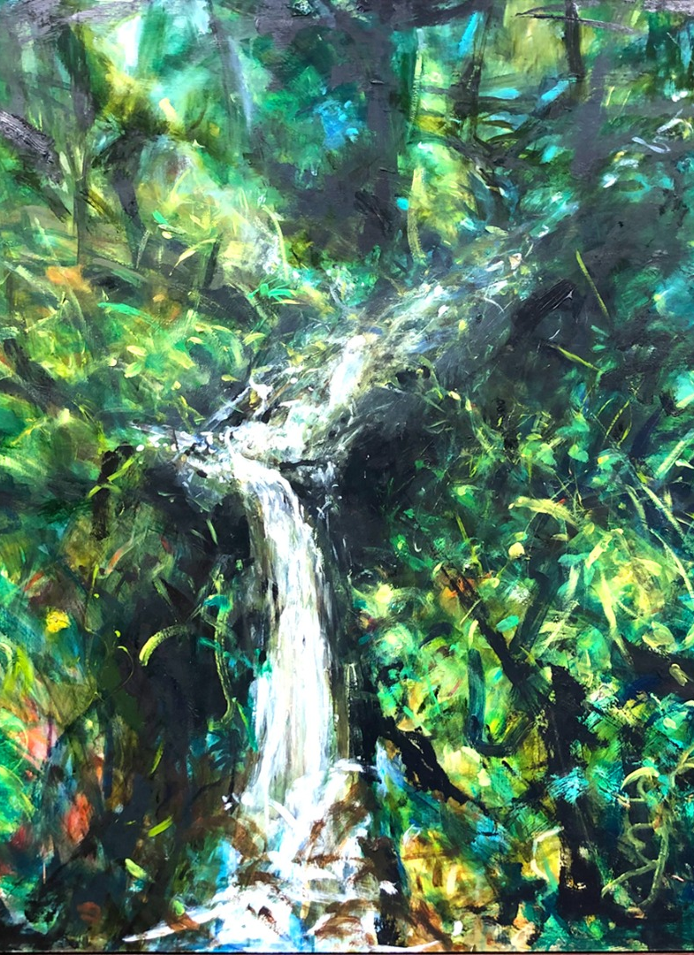
Elements 2
Looking at the picture, choose sounds from your store
Is the music quick or slow?
Loud or quiet? Or different volumes?
Where in the picture does the sound start?
…and finish?
Do we need to think about harmony? Pentatonic scales? Or will controlled cacophony work here?
Notes:
PRACTICAL
What sounds will you choose – and why? Pitched? Untuned? Mixture?
Perhaps a slow start and speeding up as the waterfall develops
The piece could start quietly (top right) and increase in volume as it hits the waterfall (centre and bottom)
If using tuned instruments, the water is hardly rippling (!), but cascading uncontrollably toward the bottom of the waterfall, suggesting randomness of notes (ie not harmony)
However, it’s seemingly peaceful, so perhaps a juxtaposition of the two?

Slide 17
Remember
When composing to pictures, the pictures are there to provide a stimulus for creativity.
Ultimately it matters not whether the music sounds like the picture.
…..although for our project that would be quite nice!

Slide 18
Summary
You may be limited by the sounds at your disposal, but be selective if poss, and/or play what’s available in a way that works for the picture (whether this is the usual way or not!)
Use word clouds to generate ideas
Organise your sound layering, how will the piece start and stop, how will you progress from one section to another
Consider dynamics, long/short sounds, wood/metal, high/low etc
If using chords/keyboards/DAWs, choose appropriate sounds (not just piano!). The more adventurous may want to try added 7ths and 9ths for more effectual chords

